Slide 1
Active Directory
Updated: February 2022

Slide 2

Summary of Information Covered
What is Active Directory
Active Directory Replication
Active Directory Hierarchy
Active Directory Tools
Active Directory Attributes
Active Directory Naming Conventions
Useful PowerShell commands

Slide 3
Active Directory (AD)
Directory is a hierarchical structure that stores information about objects on a network.
Active Directory Database (known as the data store) contains information about network resources such as servers, printers, user accounts, groups of user accounts, security policies
Windows Server 2016 and up uses Active Directory to manage accounts, groups, and many more network management services

Slide 4
Active Directory (AD)
Domain controllers (DCs)
Servers that have the AD DS server role installed
Contain writable copies of information in Active Directory
Member servers
Servers on a network managed by Active Directory that do not have Active Directory installed
Domain
Container that holds information about all network resources that are grouped within it
Each resource is called an object

Slide 5
Active Directory Replication
Multimaster replication
Each DC is equal to every other DC in that it contains the full range of information that composes Active Directory
If information on one DC changes it is replicated to all other DCs
Replication versus Syncing
Replication creates exact copy of database
Synchronization updates information to what has changed

Slide 6
Active Directory Hierarchy
The hierarchy of Active Directory include forests, trees, domains, organizational units (OU), and objects (O)
Forest
Consists of one or more Active Directory trees that are in a common relationship
Forests have the following characteristics:
The trees can use a disjointed namespace
All trees use the same schema
All trees use the same global catalog

Slide 7
Active Directory Hierarchy
Tree
Contains one or more domains that are in a common relationship
Tree has the following characteristics:
Domains are represented in a contiguous namespace and can be in a hierarchy
Two-way trust relationships exist between parent domains and child domains
All domains in a single tree use the same schema for all types of common objects
All domains use the same global catalog

Slide 8
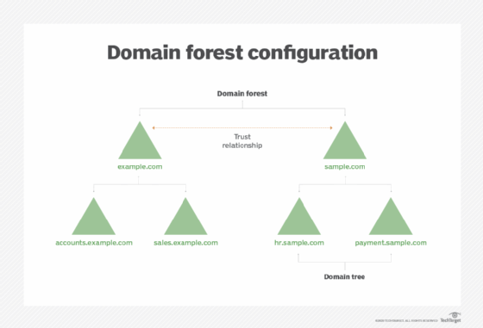
Active Directory Hierarchy
What is a Forest in Active Directory? (Explained - Best Practices) (cloudinfrastructureservices.co.uk)

Slide 9
Active Directory Hierarchy
Domains
The domains in a tree typically have a hierarchical structure
Such as a root domain at the top and other domains under the root
Organizational unit (OU)
An OU is a grouping of related objects within a domain
OUs can be nested within OUs
Group Policy or security policies can be administered to an OU

Slide 10
Active Directory Hierarchy
Objects
Users, computers, printers, shared folders, etc. are considered objects in your Domain
Each object has many attributes
Each user object has a globally unique identifier (GUID) which is deleted when object is deleted
User objects can be separated in groups for Group Policy and Security administration
Groups
Local – Manage objects on standalone server
Domain local – Group that exists within a domain
Global - Can contain other groups, can be converted to Universal Group
Universal – Groups that span domains and trees

Slide 11
Active Directory Tools
Active Directory Administrative Center
Does not always create user sAMAccount Name or will not create Home directories
For that reason we do not use ADAC for user and home directory creation
Include access to Object attributes
Active Directory Users and Computers
automatically creates sAMAccount Name and directory
Does show Object attributes
AD Recycle Bin
Works similar to computer recycle bin but must be turned on and cannot be turned off.

Slide 12
Active Directory Attributes
Each Active Directory Object contains a set of attributes
Attributes include specific names used to identify a specific AD Object
sAMAccount Name – (Pre-Windows 2000) limited characters.
Works with NetBIOS name: Domain\Username
UserprincipalName (UPN) or User Logon Name – Larger limit of characters.
Works with DNS suffix: Username@Domain.ca

Slide 13
Active Directory Attributes
Home Drive or Directory
Special type of mapped drive that contains a users folders and application data.
Similar to the local profile directory but on an server location.
Used in Roaming Profiles
Used in Folder Redirection.
Must contain:
HOMEDRIVE=<drive letter>: HOMESHARE=\\<server name>\<share name>
Created automatically in share with all correct permissions.
Only directory where users have Full Control

Slide 14
Active Directory Naming Convention
Canonical Name – Relative Distinguished Name
Domain/Location/name
Distinguished Name
cn=name, dc=domain,dc=topleveldomain
Fully Qualified Domain Name
Server.domain.domain
Common Name
CN=Object Name
UNC Path
\\Server\share\directory

Slide 15
Helpful PowerShell cmdlets (commands)
Get-Command –Module ActiveDirectory
Get-ADDomain
Get-ADDomainController –filter * | Select hostname, operatingsystem
Get-ADForest
Get-ADGroup
Get-ADGroupMembership
New-ADGroup
Get-Member
Get-ADUSer
New-ADUser
Environmental variable for users = %username%

Slide 16
Helpful PowerShell cmdlets (commands)
Set-ADUser -Identity username -ChangePasswordAtLogon $true
Get-ADUser –Identity “username” -Properties *
Get-ADUser -Filter * -Properties * | Format-Table
Set-ADUser –Identity “username” –ChangePasswordAtLogon $True
Search-ADAccount –LockedOut
Unlock-ADAccount –identity “username”
New-AdOrganizationalUnit
Get-ADOrganizationalUnit
New-ADObject
Move-ADObject
Get-ADUser -Filter * -Properties *| Format-Table Name, CanonicleName, MemberOf
Get-ADObject -Identity "ComputerDistinguishedName" -Server "HostName"
Get-SmbShareAccess –name “ShareName”

Slide 17

Questions

